Slide 1

Reduced Order Solver for the Aeroelastic Problems
Reduced Order Solver for the Aeroelasticity Equation
Billton Joseph Vitus¹ Oriol Chandre-Vila^{1,2} Joseph Morlier¹
¹ISAE Supaero, Department of Mechanics, Structures and Materials (DMSM)
²Airbus, Loads and Aeroelasticity Department
3rd April, 2020

Slide 2
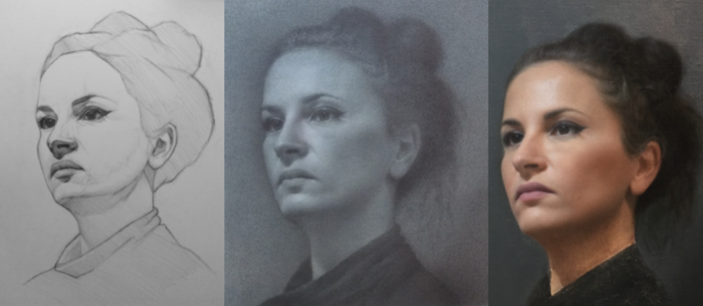
Reduced Order Modelling
Reduction of computational complexity of mathematical models in numerical simulations.
Preserving the dynamics of the physical problem for quicker solutions.
Widely used in many fields, like electronics, control, fluid mechanics etc. (Younis, JMS, 2003; Banks, IEEE, 2000; Bergmann, POF, 2005)
Out of all the mathematical formulations available for reduced order modelling, Proper Orthogonal Decomposition (POD) is widely used in industrial and academic studies. (Berkooz, ARFM, 1993; Willcox, AIAA, 2002)
The principal idea is to extract the most dominant characteristics a data set, that captures most of the dynamics.
This gives a matrix of a significantly lower dimension, with which the computations are simplified.
Fig 1. An analogy to reduced order modelling.

Slide 3
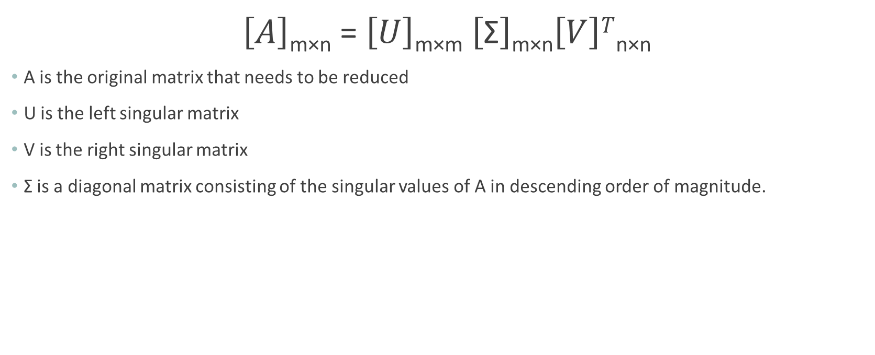
Contd.
$\left[A\right]$_{m×n} = $\left[U\right]$_{m×m} $\left[\text{Σ}\right]$_{m×n}$\left[V\right]T$_{n×n}
A is the original matrix that needs to be reduced
U is the left singular matrix
V is the right singular matrix
$\text{Σ}$ is a diagonal matrix consisting of the singular values of A in descending order of magnitude.

Slide 4
Current Understanding and Adopted Methodology
First step is creation of a data set, aka a snapshot matrix.
Several techniques exist for creating the snapshot matrix, most prominent one is capturing the output vector at different intervals of a high fidelity simulation (Lucia, JOA, 2005).
Published literature recommend using various strategies for regularity of ROM throughout different analysis conditions, like varying angles of attack, mach number (Liu, AIAA, 2005), structural modes (Thomas, JOA, 2003) etc.
Apply POD to the snapshot matrix and identify the dominant modes, by analyzing the diagonal values of the Σ matrix.
If r is the number of dominant singular values, a reduced order matrix of r columns, either U or V, is considered for further computations.

Slide 5
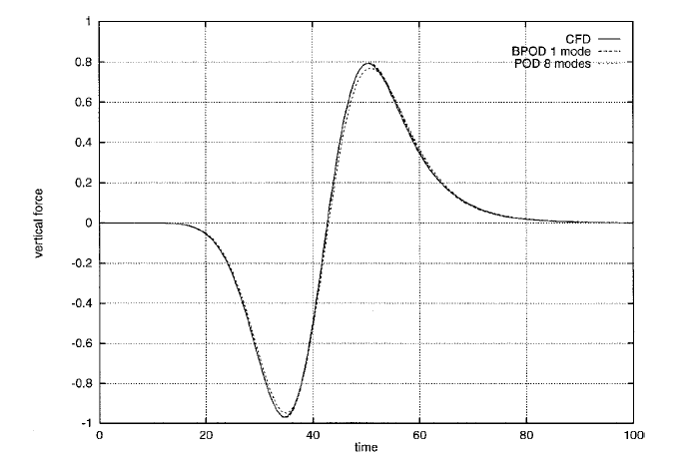
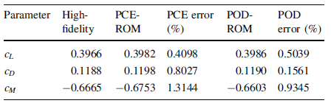
Results
Fig 3. Comparison of HCE and POD for ROM ( Nikbay, CEAS, 2015)
Fig 4. Response to a pulse input in Plunge, for NACA0012 airfoil. Full order CFD simulation consists of 13, 928 states (Willcox, AIAA, 2002

Slide 6
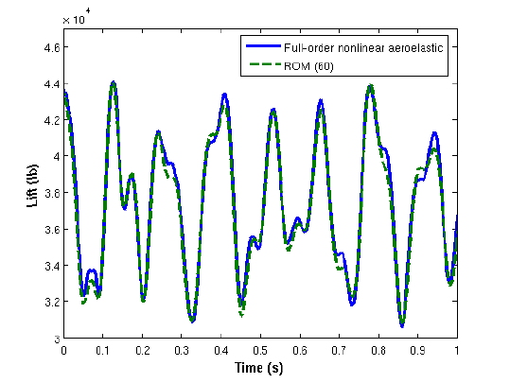
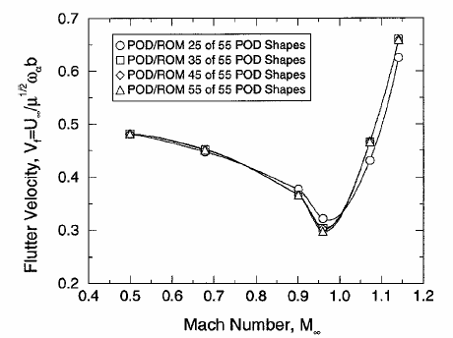
Results (contd.)
Fig 2. ROM and full order analysis comparison for a F-16 aircraft (Lieu, AIAA, 2005)
Fig 3. Comparison of different POD orders ( Thomas, JOA, 2003)

Slide 7
Future Work
More research into creation of snapshot matrix.
Learning high fidelity simulation models.
Apply the reduced order modelling methodology to a Goland Wing test case.
Expanding methodology to a blended wing body aircraft.

Slide 8
Bibliography
Berkooz, G., Holmes, P., & Lumley, J. L. (1993). The proper orthogonal decomposition in the analysis of turbulent flows. Annual review of fluid mechanics, 25(1), 539-575.
Willcox, K., & Peraire, J. (2002). Balanced model reduction via the proper orthogonal decomposition. AIAA journal, 40(11), 2323-2330.
Thomas, J. P., Dowell, E. H., & Hall, K. C. (2003). Three-Dimensional Transonic Aeroelasticity Using Proper Orthogonal Decomposition-Based Reduced-Order Models. Journal of Aircraft, 40(3), 544–551. doi: 10.2514/2.3128
Lieu, T., & Farhat, C. (2005). Adaptation of POD-based Aeroelastic ROMs for Varying Mach Number and Angle of Attack: Application to a Complete F-16 Configuration. 2005 U.S. Air Force T&E Days. doi: 10.2514/6.2005-7666
Nikbay, M., & Acar, P. (2015). Reduced order modelling for static and dynamic aeroelastic predictions with multidisciplinary approach. CEAS Aeronautical Journal, 6(3), 455–469. doi: 10.1007/s13272-015-0154-3
Xie, D., Xu, M., & Dowell, E. H. (2014). Proper Orthogonal Decomposition Reduced-Order Model for Nonlinear Aeroelastic Oscillations. AIAA Journal, 52(2), 229–241. doi: 10.2514/1.j051989
Hesse, H., & Palacios, R. (2014). Reduced-Order Aeroelastic Models for Dynamics of Maneuvering Flexible Aircraft. AIAA Journal, 52(8), 1717–1732. doi: 10.2514/1.j052684
Kim, T., Hong, M., Bhatia, K. G., & Sengupta, G. (2005). Aeroelastic Model Reduction for Affordable Computational Fluid Dynamics-Based Flutter Analysis. AIAA Journal, 43(12), 2487–2495. doi: 10.2514/1.11246

